Slide 1
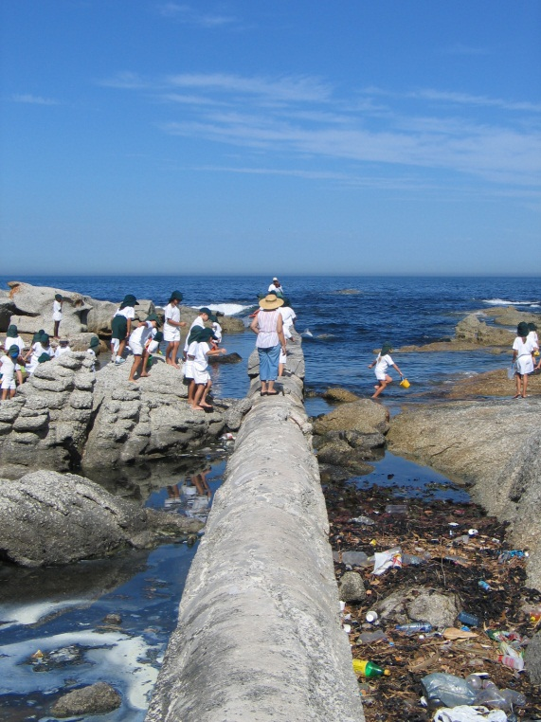
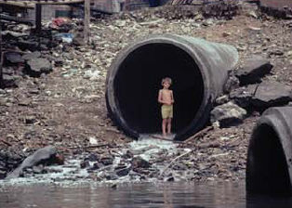
Section 69 of the Integrated Coastal Management Act
Nitasha Baijnath-Pillay
Directorate: Coastal Pollution Management
Chief Directorate: Integrated Coastal Management

Slide 2
Background
DWA (F) mandate over Coastal Water abstraction & water use under the National Water Act
Responsibility for coastal water management : DEA (Integrated Coastal Management Act of 2008)
ICMA commenced on 1 Dec 2009

Slide 3
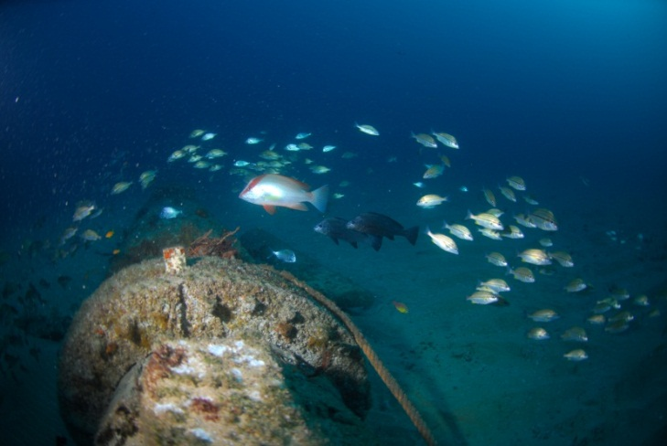
  Integrated Coastal Management Act (2008)
Chapter 8: Marine and Coastal Pollution Control
  S69: Discharge of effluent into coastal waters
    Coastal Waters Discharge Permit (CWDP) (originates from a source on land)
    General authorization
    Estuary – Minister’s approval (DEA and DWA)

Slide 4
To date, the DEA has:
Applications (receiving)
Developed Draft Assessment Criteria (being finalised for all new applications)
Reviewed and Updated the Operational Policy for Coastal Waters Discharges
  Roles and responsibilities,
  Rules and principles
  Management framework (legislative mandate and procedure + validity period of permits)

Slide 5
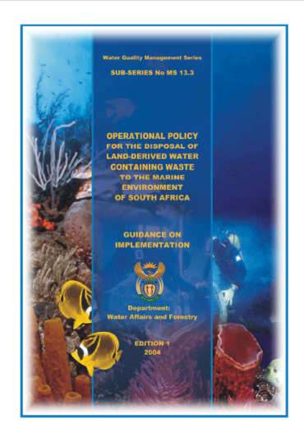
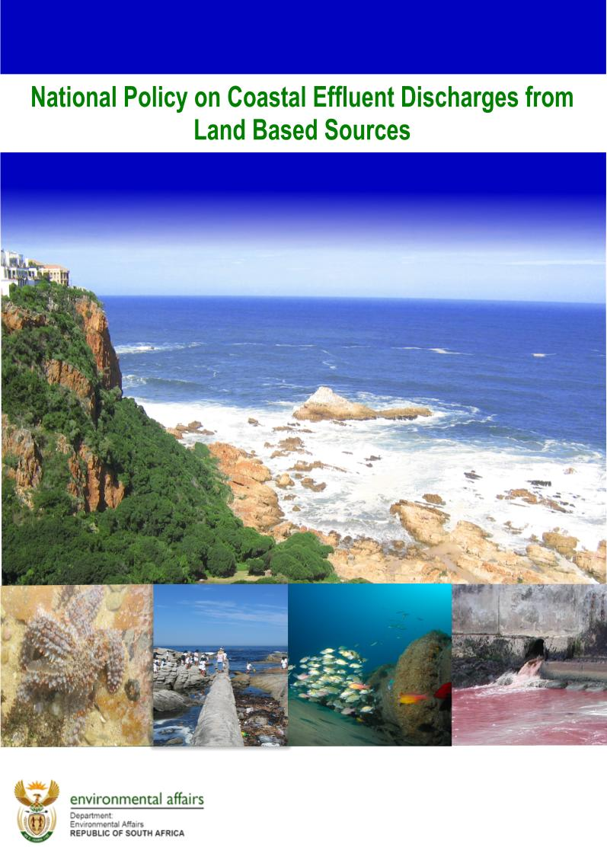
Policy development

Slide 6
Reason for the updating
Old yet very useful document
Legislative gap
Shift in approach
  water use management Env resource protection
  Sea was not regarded as a resource under the DWA – hence no regulations developed for coastal env protection

Slide 7
National Policy on coastal effluent disposal from land-based sources
Goal, Principles and Ground rules
  Legislative Framework
  Management institutions and Administrative Responsibilities
  Environmental Quality Objectives
  Activities and Associated Waste Loads
  Scientific and Engineering Assessment
  Monitoring and Contingency Plans.

Slide 8
  Rules: Legislative Framework
1. Any process that heats and / or generates and discharges any effluent to the coastal environment must be authorised to do so by the DEA in terms of section 69 of the ICMA.
2. Any discharge from an activity triggering any of the Listing Notices in the (EIA) Regulations = EA or CWDP under the ICM Act unless it conforms a standard as prescribed in section 24 of the NEMA and in terms of the ICMA.

Slide 9
Legislative Framework
3. A CWDP is valid for a period up to 5 years subject to a midterm review (negative impacts on the environment and non-compliance with permit conditions).
4. The discharge a Marine Protected Area under the Marine Living Resources Act (Act No. 18 of 1998) is prohibited, unless the Minister of Environmental Affairs provides permission to do so (improve the env).

Slide 10
Legislative Framework
5. Any land-based effluent discharge to the coastal environment may be subject to a disposal charge to be developed in consultation with stakeholders.

Slide 11
Rules: Management Institutions & Administrative Responsibilities
6. The DEA will work in consultation with relevant local, provincial and national government departments (DWA in cases where discharge occurs in an estuary), as well as local management institutions (such as pipeline or catchment forums) = to ensure effective cooperative governance
7. The discharge of land-based effluent to the coastal environment must be managed through a local management institution such as the establishment of forums (existing institutions (govt and non govt)

Slide 12
Rules: Sensitive Areas
8. Estuaries
Considered only in exceptional circumstances (to improve flow or to improve / maintain the resource quality objectives
In consultation with DWA
9. Surf zone
discharge of municipal and industrial effluent = avoided
Where legitimate motivation (e.g. abstraction and discharge) the EQO must be met (salinity alterations and aesthetics/visibility)

Slide 13
Sensitive Areas
10. Discharges of land-based effluent to the offshore coastal waters through a coastal outfall should be considered as the preferred option over any estuary or surf zone discharge, unless the suitability of the areas to accommodate such activities is properly assessed.

Slide 14
Rules: Environmental Quality Objectives (EQO)
11. Site-specific environmental quality objectives for the coastal environment (excluding estuaries) must take into account the South African Water Quality Guidelines for coastal marine waters (RSA DWAF, 1995a).
- In instances where a standard is proposed and for which concurrence is required from the DEA, such a standard must be in line with this policy, more stringent, applicable and responsive.

Slide 15
Environmental Quality Objectives
12. Where, in exceptional circumstances, a discharge to an estuary is considered, resource (environmental) quality objectives must be determined according to the methodology for estuaries developed by the DWA. Estuaries are included in NWA + take in to account the provisions of the NWA.
13. EQO must be complied with in the area beyond the initial mixing zone.

Slide 16
Rules: Waste Loads - Municipal Effluent
14. Water scarce: only be considered where it has been evaluated in terms of the Water Services Development Plan for a particular municipal area and which, in turn, forms part of the Integrated Development Plans. This requirement supports the concept of a ‘Master Plan for water supply/demand and effluent treatment’.

Slide 17
Waste Loads - Municipal Effluent
15. Municipal WWTWs receiving industrial effluent (also referred to as trade effluent)
will be subject to the Ground Rules for Industrial Effluent (refer to Rules 19 to 22).
Service Providers or Local Authorities operating such treatment works will be required to prepare industrial effluent management plans (as part of the ‘Master Plan’).
It is also the responsibility of the Service Provider or Local Authority to investigate possible synergistic and/or cumulative effects which may occur as a result of the interaction between different (industrial) effluent inputs.

Slide 18
Waste Loads - Municipal Effluent
16. The design, construction and management of collection systems = outside the scope of this policy. must comply with related policies and specifications of the DWA and DEA.

Slide 19
Waste Loads - Municipal Effluent
17. Levels of treatments of MUNICIPAL effluent
  Primary treatment: minimum for all new or proposed discharges to the offshore coastal environment.
  Preliminary treatment: minimum for all existing discharges to the offshore coastal environment (provided that the receiving environment is suitable for this coastal discharge and that the environmental (or resource) quality objectives are met)
  However, future expansions or upgrades to such existing coastal outfalls will require primary treatment of the effluent prior to discharge unless it can be proven that key socio-economic factors require otherwise. Nevertheless, environmental (or resource) quality objectives must still be met and take into account the interest of the whole community.

Slide 20
Waste Loads - Municipal Effluent
  Secondary treatment with disinfection - minimum for all discharges of municipal effluent to the surf zone and estuaries (where such discharges are allowed)
treatments apply after the publication of this Policy
NOTE: The above sets the minimum requirements.
NOTE: Where such levels of treatment still do not meet the requirements of the receiving environment - higher levels of treatment will be required.
NOTE: In order to determine realistic objectives, applications for a CWDP will be evaluated on a case- by- case basis.
NOTE: Receiving environmental objectives will dictate the level of treatment required for discharges not covered under municipal effluent (e.g. industrial effluent).

Slide 21
Waste Loads - Municipal Effluent
18. The discharge of sludge arising from effluent treatment facilities (e.g. primary, secondary and tertiary) must be in accordance with the Minimum Requirements for Waste Disposal by Landfill (DWAF, 1998) and the ‘Sludge Guidelines’ (1998 as amended in 2000) of the DWA or any future updates of such policies or guidelines

Slide 22
Waste Loads - Industrial Effluent
19. Industrial discharges not defined in the ICMA but in S21 of the NWA:
  Water used in an industrial process on land.
  Contaminated (or polluted) stormwater run-off originating from industrial areas that passes through man-made structures directly into the estuary, surf zone or coastal waters,
  freshwater or seawater used as cooling water
  Seawater used in an industrial process on land
  The above classification remains valid until appropriate regulations have been developed under the ICMA.

Slide 23
Waste Loads - Industrial Effluent
20. An industry, discharging effluent to a municipal WWTW or directly to the coastal environment - to provide a detailed description of the waste stream in terms of both volume (quantity) and quality
Where industries discharge effluent to a WWTW, the water services provider is responsible for obtaining this information from the industry concerned..

Slide 24
Waste Loads - Industrial Effluent
21. Industrial effluent discharged to a municipal WWTW disposing to the coastal environment will be subject to appropriate pre-treatment. It is the responsibility of the local authority operating the WWTW to ensure compliance in this regard.
22. Effluent containing radioactive substances is governed by the Department of Energy (in concurrence with the DEA and DWA)

Slide 25
Waste Loads - Industrial Effluent
23. Diffuse land-based effluent (such as urban stormwater run-off, agricultural return flows and contaminated groundwater seepage) discharged into the coastal environment should not have any negative impact on the receiving environment, i.e. the environmental quality objectives must be met.

Slide 26
Rules: Scientific & Engineering Assessment
24. An application for a CWDP will only be considered where a holistic process has been followed
potential impacts on the receiving environment (near and far field)
other anthropogenic activities and waste inputs
address possible synergistic and/or cumulative effects.

Slide 27
Scientific & Engineering Assessment
25. CWDP application considered where a discharge system is designed, constructed and operated in accordance with recognised scientific, hydraulic and structural guidelines in order to meet EQO.
26. Recognised numerical modelling techniques must be applied in the scientific and engineering assessment and design of a coastal disposal system.

Slide 28
Scientific & Engineering Assessment
27. A precautionary approach must be followed in the assessment and design of any coastal disposal system in which the temporal and spatial coverage and accuracy of physical and chemical oceanographic data do not adequately describe site-specific conditions

Slide 29
Rules: Monitoring & Contingency Plans
28. Any authority or industry responsible for the operation and management of a coastal disposal system will be subject to the implementation of a monitoring programme.
29. Authorities operating WWTW that receive industrial effluent must ensure that monitoring programmes are implemented to record the individual flow and composition of such effluent inputs prior to entering the effluent reticulation system, as part of their industrial effluent management

Slide 30
Monitoring & Contingency Plans
30. Required to prepare contingency plans pertaining to maintenance shutdowns, failure in operations or emergency incidents (Incl S30 of the NEMA provision).
31. Required to provide a regular evaluation of the performance of the coastal disposal system. (DEA will consult with the DWA in the case of a discharge into an estuary).

Slide 31
Monitoring & Contingency Plans
32. Where non-compliance - required to propose mitigating actions to ensure compliance (e.g. rehabilitation or alternative treatment options at own costs). Approval for such actions is needed from DEA 1st.
33. The decommissioning of a coastal discharge structure must be addressed in the planning stages as part of the EIA process (if an EIA is required), supporting the cradle-to-grave principle. Existing: stakeholder negotiations and duty of care.

Slide 32
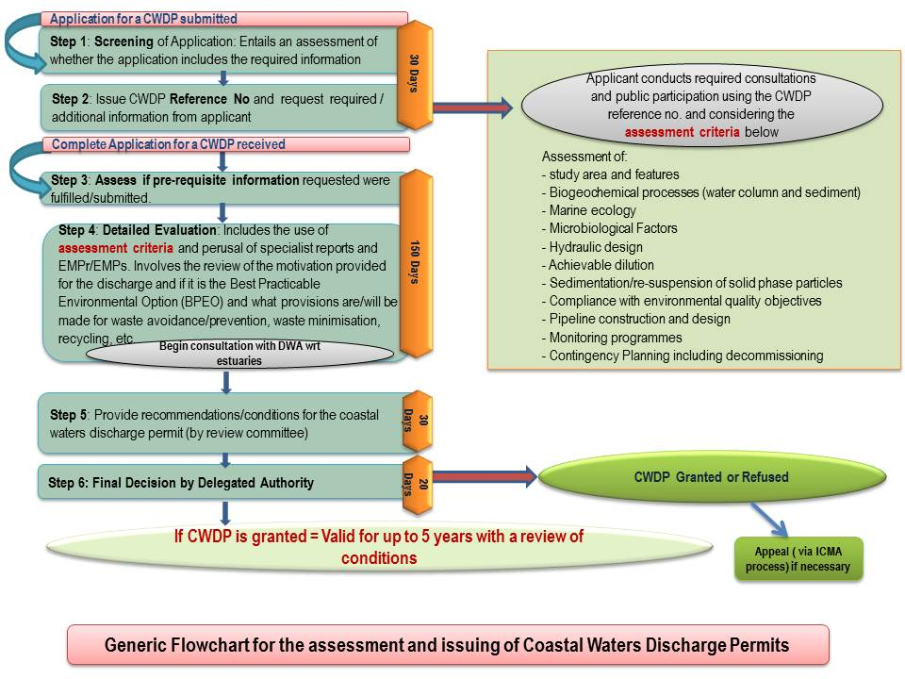

Slide 33
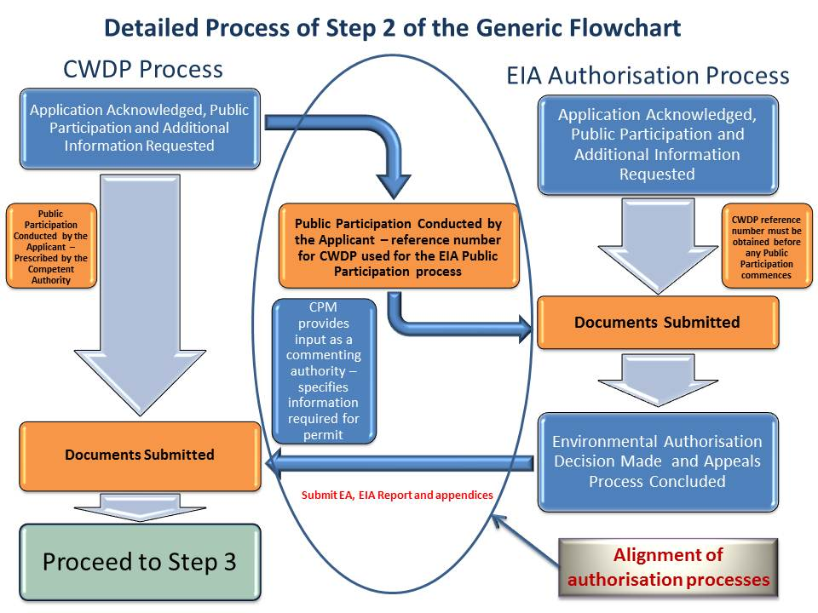

Slide 34
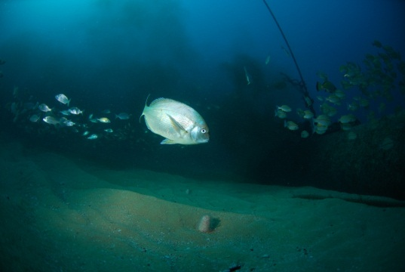
Implications
A process of 200 days for evaluation and issuing of a decision (<7 months)
Applications can be lodged in parallel to EA where a CWDP will be needed
Scientific evidence we require can be conducted and reported on via the EA process
PP can be run concurrently (impt that it has the CWDP Ref no.)

Slide 35
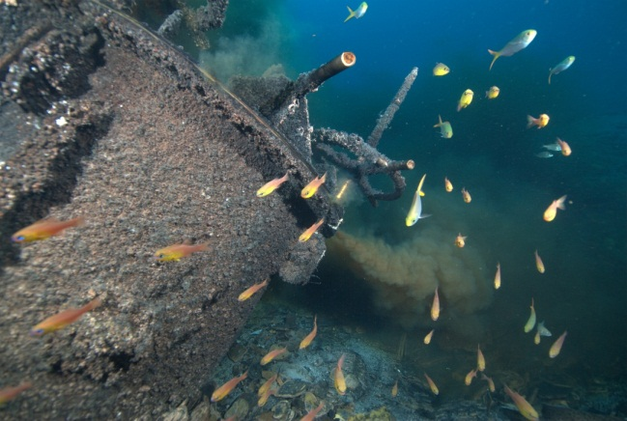
Review of Existing Licences by DWA
With 5 years of commencement of the ICM Act = complete review of all authorisations
  prohibit the activity
  recommend for continuation – but must apply for a CWDP as a new application for the first time (requirements must be met)
  Recommend for continuation (discharge into estuary) = joint review with DWA

Slide 36
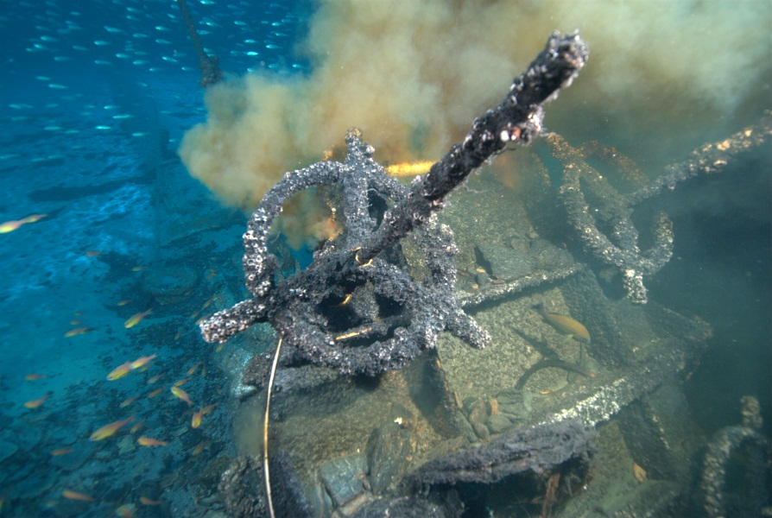
Where we are now
Draft Regulations on CWDP
Will begin this process as of 1 April 2014
  Required: DWA database and files of existing authorisations
  Legal standing to obtain these.

Slide 37
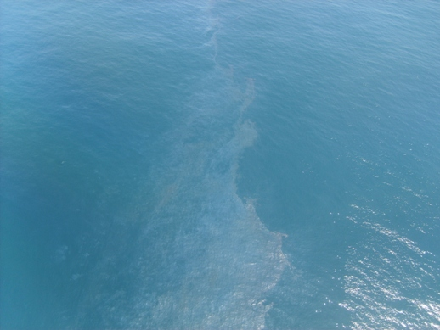
THANK YOU

Slide 38
Sub-Directorate: Land-based Sources of Marine Pollution
Directorate: Coastal Pollution Management
Ms. Nitasha Baijnath-Pillay
Tel. 021 – 819 2409
Email: nbpillay@environment.gov.za
Mr. Mulalo Tshikotshi
Tel.: 021 – 819 2455
Email: Mtshikot@environment.gov.za
Mr. Clement Arendse
Tel. 021 – 819 2454
Email: carendse@environment.gov.za

